Slide 1
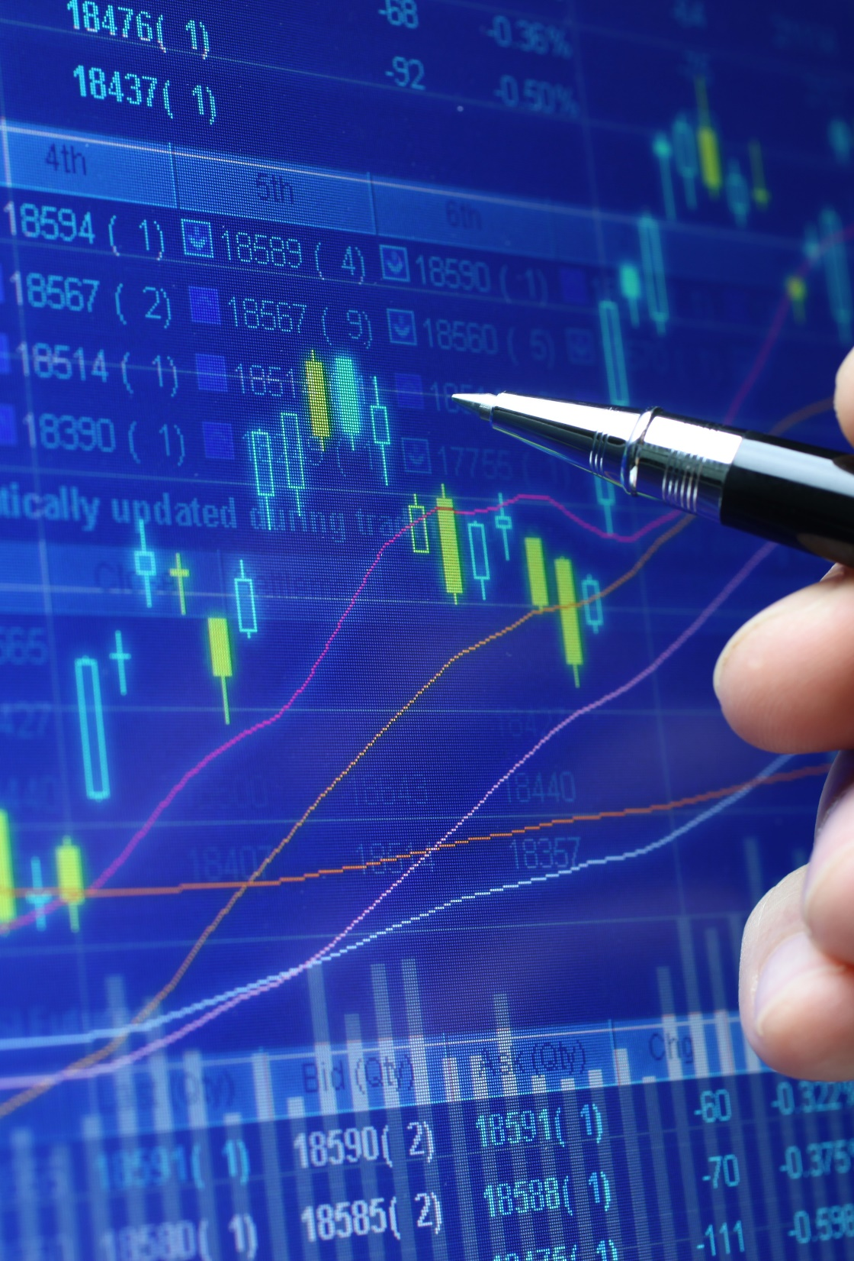
OUTLINE
Purpose of WTF we doin
Background Information
VIX
VIX contracts
Backtester
Optimization
LO
WFA
Objective functions
Sharpe Ratio
Annualized Return/Max Drawdown
WFA results

Slide 2
Who we are and wtf we are doing

Slide 3
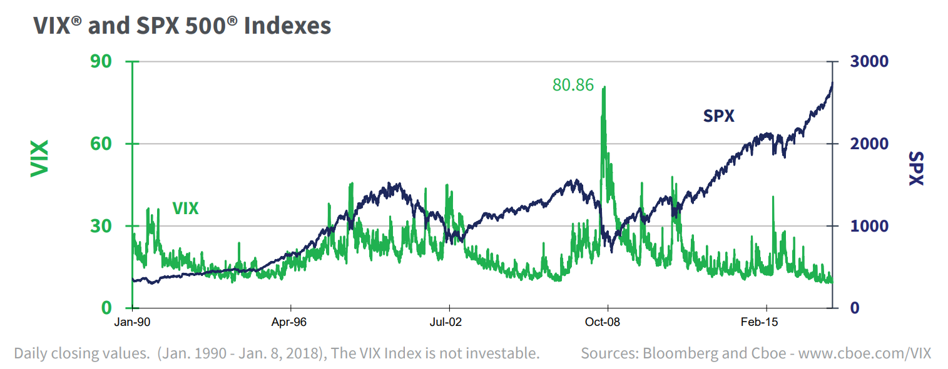
VIX (Volatility Index)
What is the VIX?
Created by the Chicago Board Options Exchange (CBOE), the VIX is a market index (a non-tradeable market statistic) that, in essence, measures the price of insurance on stocks (the S&P 500).
It is also known as the "Fear Gauge" or "Fear Index”.
2
3

Slide 4
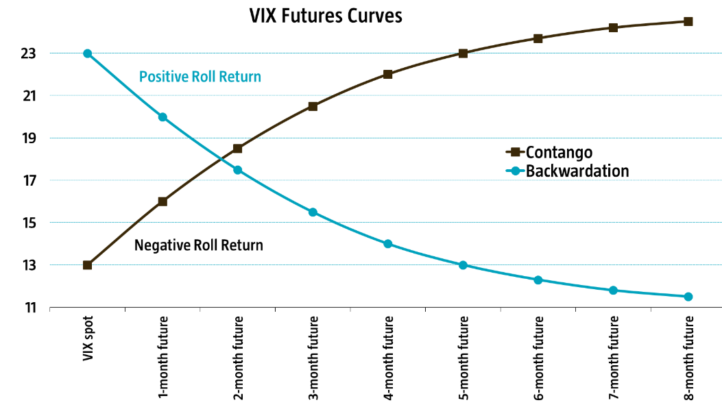
In contango, contracts further out in time trade at a premium. In backwardation, the opposite is true.
Negative roll return/contango represents volatility risk premium (return you would make for exposing yourself to the risk).
General Strategy: Sell the futures contracts when the curve is in contango and buy them when it is in backwardation.
Notes:
Futures contracts are financial instruments that allow hedgers or speculators to buy or sell an underlying or reference asset at a specific point in time in the future.
How do they work?
Cash Settlement on VIX index. Meaning the buyers and sellers of the futures contracts exchange cash at expiration. The amount exchanged being the difference between the price of the contract and the level of the index.
Put simply, future contracts are the way to purely bet on the level of the VIX at a point in the future
So that is a crash course in the particular asset we have decided to target, but say we want to deploy this strategy with real trading capital…. How would we determine if this strategy stands a chance of making a profit, or ideally a superior risk-adjusted return to other investment opportunities
We can test the strategy on historical data to see how it would have performed in the past… which is called backtesting

Slide 5
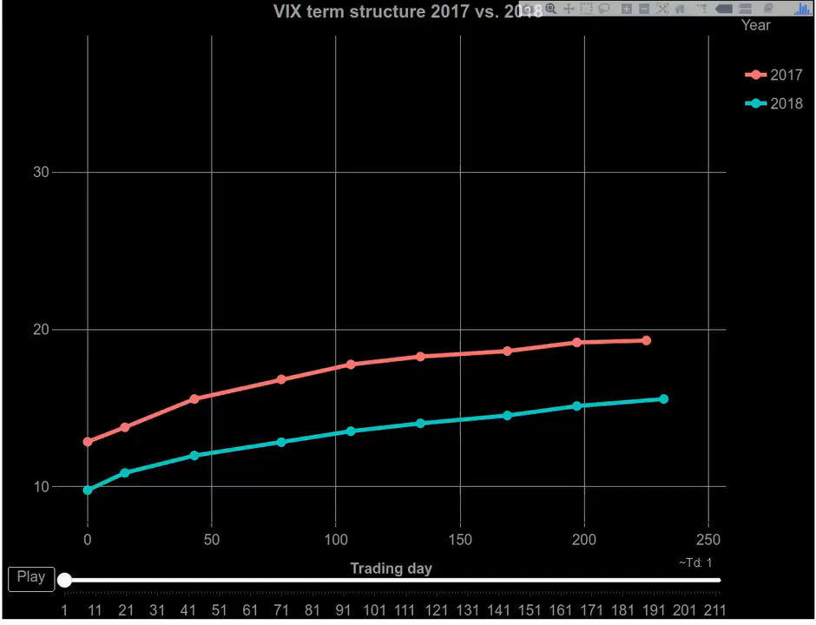

Slide 6

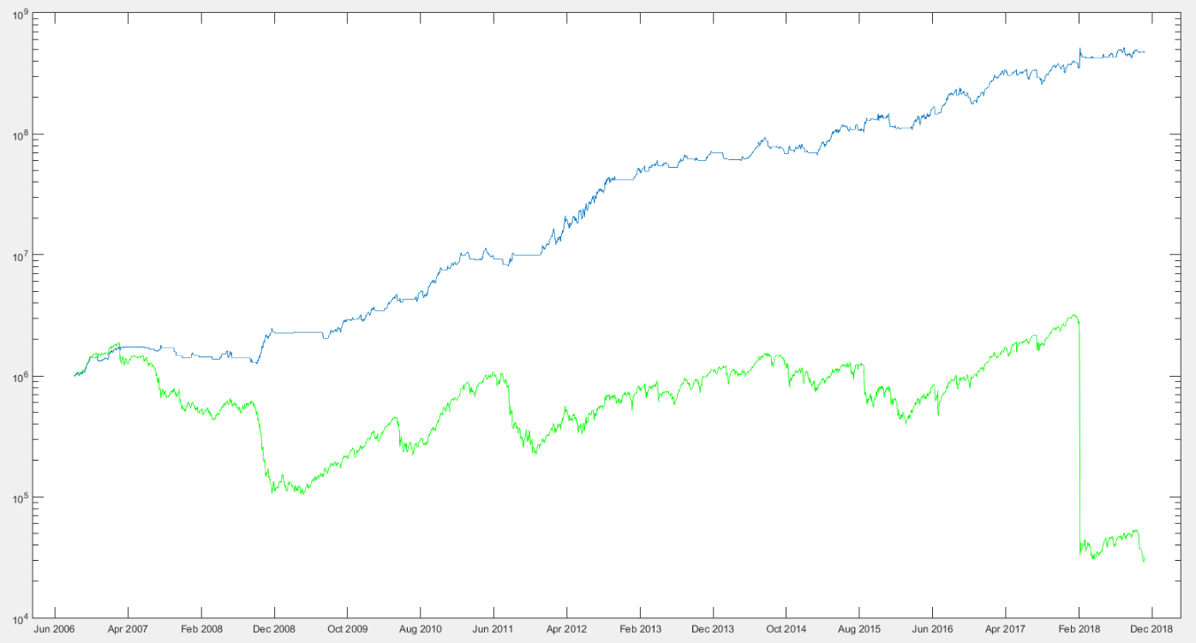
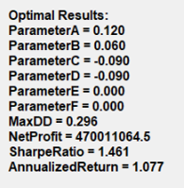
Equity Curve (Performance Evaluation)
The Equity Curve is the hypothetical account balance.

Slide 7
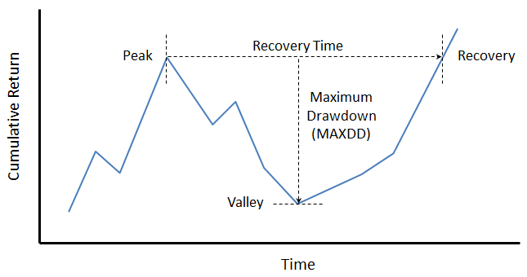
Objective Functions
Sharpe Ratio
The Sharpe ratio was developed by Nobel laureate William F. Sharpe, and is used to help investors understand the return of an investment compared to its risk. The ratio is the average return earned in excess of the risk-free rate per unit of volatility or total risk.
Annualized Total Return/ Maximum Drawdown
An annualized total return is the geometric average amount of money earned by an investment each year over a given time period. It is calculated as a geometric average to show what an investor would earn over a period of time if the annual return was compounded. An annualized total return provides only a snapshot of an investment's performance and does not give investors any indication of its volatility.
A maximum drawdown (MAXDD) is the maximum loss from a peak to a trough of a portfolio, before a new peak is attained. Maximum Drawdown is an indicator of downside risk over a specified time period. It can be used both as a stand-alone measure or as an input into other metrics.
4
5
6
7

Slide 8

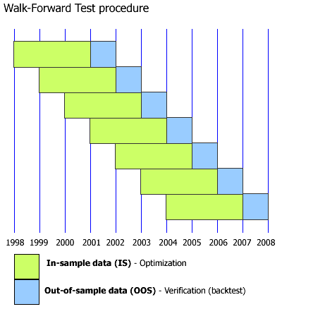
Overfitting/Walk Forward Analysis

